Slide 1
topicNine
Cascading Style Sheet

Slide 2
Learning Objectives
At the end of this chapter the students should be able to:
To use class selector to apply styles into html attributes.
To use style sheet to give all web pages of the websites the same format and layout.
To specify standard font, font color, font size, and others aspect of text
To create a style sheet that governs the total appearance of the whole website.
To specify the form styles of the web pages.

Slide 3
Introduction
What is CSS?
CSS stands for Cascading Style Sheets
Styles define how to display HTML elements
Styles are normally stored in Style Sheets
Styles were added to HTML 4.0 to solve a problem
External Style Sheets can save you a lot of work
External Style Sheets are stored in CSS files
Multiple style definitions will cascade into one

Slide 4
Style Sheets Can Save a Lot of Work
Styles sheets define HOW HTML elements are to be displayed, just like the font tag and the color attribute in HTML 3.2.
Styles are normally saved in external .css files.
External style sheets enable you to change the appearance and layout of all the pages in your Web, just by editing one single CSS document.
CSS is a breakthrough in Web design because it allows developers to control the style and layout of multiple Web pages all at once.
As a Web developer you can define a style for each HTML element and apply it to as many Web pages as you want.
To make a global change, simply change the style, and all elements in the Web are updated automatically.

Slide 5
Multiple Styles Will Cascade Into One
Style sheets allow style information to be specified in many ways.
Styles can be specified inside a single HTML element, inside the <head> element of an HTML page, or in an external CSS file.
Even multiple external style sheets can be referenced inside a single HTML document.

Slide 6
Cascading Order
What style will be used when there is more than one style specified for an HTML element?
Generally speaking we can say that all the styles will "cascade" into a new "virtual" style sheet by the following rules, where number four has the highest priority:
Browser default
External style sheet
Internal style sheet (inside the <head> tag)
Inline style (inside an HTML element)

Slide 7
Cascading Order
So, an inline style (inside an HTML element) has the highest priority, which means that it will override a style declared inside the <head> tag, in an external style sheet, or in a browser (a default value).

Slide 8
Inline style
Internal style sheet
External style sheet
Browser default

Slide 9
The advantages of using Cascading Style Sheet
Separating style from contents
Improved usability
Simplify presentation
Protecting website styles
Standardize the web pages appearance

Slide 10
CSS : Syntax
The CSS syntax is made up of three parts: a selector, a property and a value
selector {property: value}
The selector is normally the HTML element/tag you wish to define, the property is the attribute you wish to change, and each property can take a value.
The property and value are separated by a colon, and surrounded by curly braces

Slide 11
CSS : Syntax
The CSS syntax is made up of three parts: a selector, a property and a value
selector {property: value}
The selector is normally the HTML element/tag you wish to define, the property is the attribute you wish to change, and each property can take a value.
The property and value are separated by a colon, and surrounded by curly braces

Slide 12

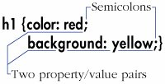

Slide 13
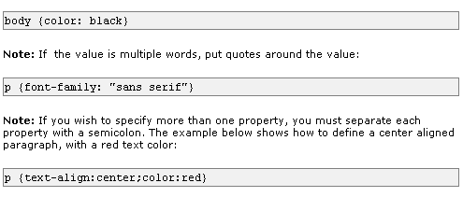
CSS : Syntax

Slide 14
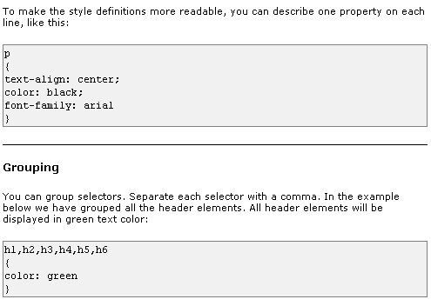

Slide 15
A Property's Value
Each CSS property has different rules about what values it can accept.
Some properties only accept one of a list of predefined values.
Others accept numbers, integers, relative values, percentages, URLs, or colors.
Some can accept more than one type of value.

Slide 16
A Property's Value: Inherit
You can use the inherit value for any property when you want to explicitly specify that the value for that property be the same as that of the element's parent.

Slide 17

A Property's Value:Predefined Values
Most CSS properties have a few predefined values that can be used.
For example, the display property can be set to block, inline, list-item, or none.
In contrast with HTML, you don't need to and indeed must not enclose predefined values in quotation marks.
Many CSS properties will only accept values from a predefined list.
Type them exactly and do not enclose them in quotation marks.

Slide 18

A Property's Value: Lengths and Percentages
Many CSS properties take a length for their value.
All length values must contain a quantity and a unit, with no spaces between them, for example, 3em or 10px.
The only exception is 0, which may be used with or without units.
Lengths must always explicitly state the unit.
There should be no space between the unit and the measurement

Slide 19
A Property's Value: Lengths and Percentages
There are length types that are relative to other values.
An em is usually equal to the element's font-size, so 2em would mean "twice the font-size".
The ex should be equal to the font's x-height, that is, the height of a letter x in the font, but it's not well supported.
Pixels (px) are relative to the resolution of the monitor though not to other style rules

Slide 20

A Property's Value: Lengths and Percentages
There are also the largely self-explanatory absolute units inches (in), centimeters (cm), millimeters (mm), points (pt), and picas (pc).
In general, you should only use absolute lengths when the size of the output is known.
Percentages are generally relative to the parent element.

Slide 21

A Property's Value: Bare Numbers
A very few CSS properties accept a value in the form of a number, without a unit, like 3.
The most common are line-height and z-index.
Don't confuse numbers and integers with length.
A number or integer has no unit (like px).
In this case, the value shown here is a factor that will be multiplied by the font-size to get the line-height.

Slide 22

A Property's Value: URLs
Some CSS properties allow you to specify the URL of another file.
In that case, use url(file.ext), where file.ext is the path and file name of the desired document.
Note that the specifications state that relative URLs should be relative to the style sheet and not the HTML document.
URLs in CSS properties do not need to be enclosed in quotation marks.

Slide 23
A Property's Value: URLs
While you may use quotations around the file name, they're not required.
On the other hand, there should be no space between the word url and the opening parentheses.
White space between the parentheses and the address is allowed but not required.

Slide 24
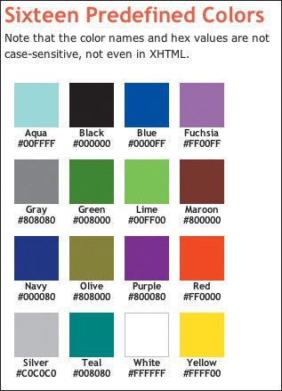
A Property's Value: CSS Colors
There are several ways to specify colors for CSS properties.
First, and easiest, the value can be one of 16 predefined color names.
Of course, 16 colors get pretty boring pretty quickly.

Slide 25
A Property's Value: CSS Colors
Instead of limiting yourself to those colors, you can construct your own by specifying the amount of red, green, and blue in the desired color.
You can give the values of each of these contributing colors as a percentage, a number from 0255, or a hexadecimal representation of the number

Slide 26

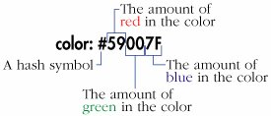

Slide 27
The class Selector
With the class selector you can define different styles for the same type of HTML element.
Say that you would like to have two types of paragraphs in your document: one right-aligned paragraph, and one center-aligned paragraph.
Here is how you can do it with styles:

Slide 28
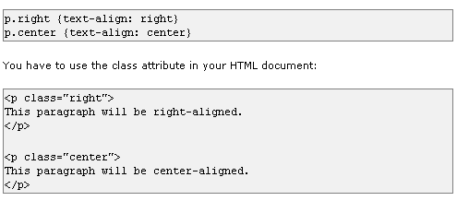

Slide 29
Add Styles to Elements with Particular Attributes
You can also apply styles to HTML elements with particular attributes.
The style rule below will match all input elements that have a type attribute with a value of "text":
input[type="text"] {background-color: blue}

Slide 30
How to Insert a Style Sheet
When a browser reads a style sheet, it will format the document according to it. There are three ways of inserting a style sheet:
External
Internal
Inline

Slide 31
HTML File
HTML File
HTML File
HTML File
Background Picture
Background Picture
Background Picture
Internal/inline
External

Slide 32
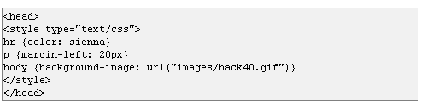
Internal Style Sheet
An internal style sheet should be used when a single document has a unique style. You define internal styles in the head section by using the <style> tag, like this:

Slide 33

Inline Styles
An inline style loses many of the advantages of style sheets by mixing content with presentation.
Use this method sparingly, such as when a style is to be applied to a single occurrence of an element.
To use inline styles you use the style attribute in the relevant tag.
The style attribute can contain any CSS property.
The example shows how to change the color and the left margin of a paragraph:

Slide 34
External Style Sheet
An external style sheet is ideal when the style is applied to many pages.
With an external style sheet, you can change the look of an entire Web site by changing one file.
Each page must link to the style sheet using the <link> tag.
The <link> tag goes inside the head section:

Slide 35
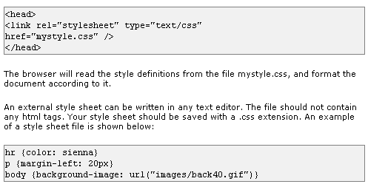

Slide 36
Offering Alternate Style Sheets
You can link to more than one style sheet and let visitors choose the styles they like best.
To offer alternate style sheets:
To designate the style sheet that should be used as a base, regardless of the visitor's preferences, use the simple syntax with no title.
To designate the style sheet that should be offered as a first choice, but that can be deactivated by another choice, add title="label" to the link element, where label identifies the preferred style sheet.
To designate a style sheet that should be offered as an alternate choice, use rel="alternate stylesheet" title="label" in the link element, where label identifies the alternate style sheet

Slide 37
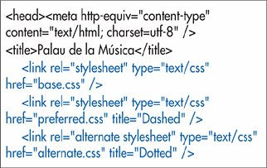
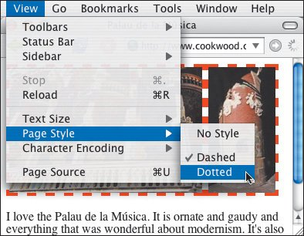

Slide 38
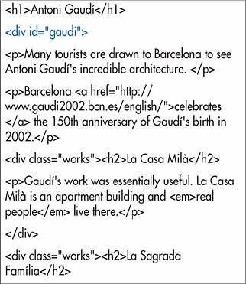
Selecting Elements by ID or Class
If you've labeled elements with an id or class, you can use that criteria in a selector to apply formatting to only those elements that are so labelled. The division with an id of gaudi encloses almost the entire page (everything but the initial h1).

Slide 39
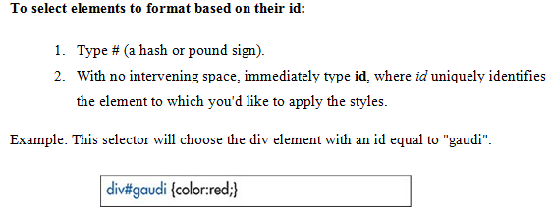
You can use class and id selectors alone or together with other selector criteria. For example, .news {color: red;} would affect all elements with the news class, while h1.news {color: red;} would affect only the h1 elements with the news class.

Slide 40
CSS Example
All Examples
http://www.w3schools.com/css/css_examples.asp
CSS Background
http://www.w3schools.com/css/css_background.asp
CSS Text
http://www.w3schools.com/css/css_text.asp
CSS Font
http://www.w3schools.com/css/css_font.asp
CSS Border
http://www.w3schools.com/css/css_border.asp

Slide 41
CSS Example
CSS Outline
http://www.w3schools.com/css/css_outline.asp
CSS Margin
http://www.w3schools.com/css/css_margin.asp
CSS Padding
http://www.w3schools.com/css/css_padding.asp
CSS List
http://www.w3schools.com/css/css_list.asp
CSS Table
http://www.w3schools.com/css/css_table.asp

Slide 42
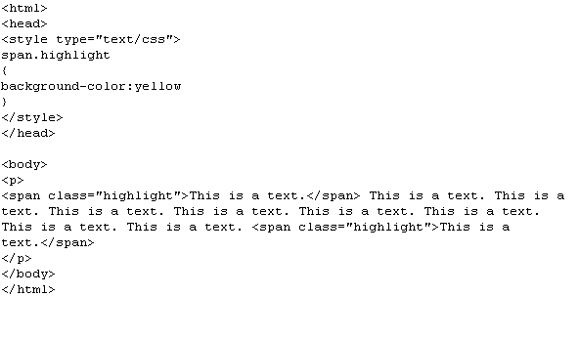
Example 1

Slide 43
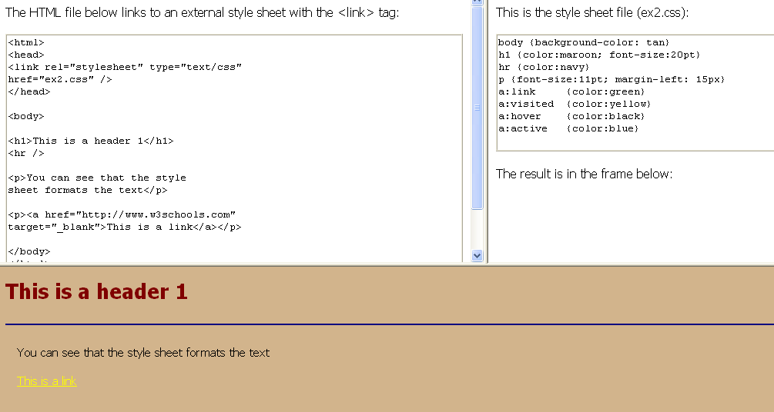

Slide 44
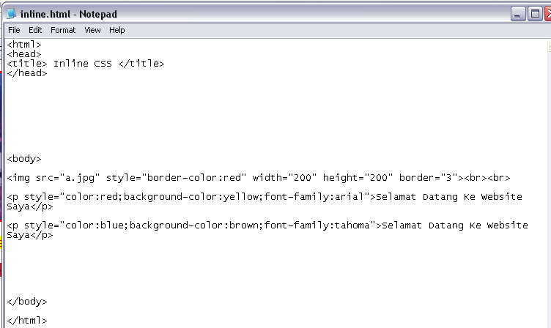
Exercise 1

Slide 45
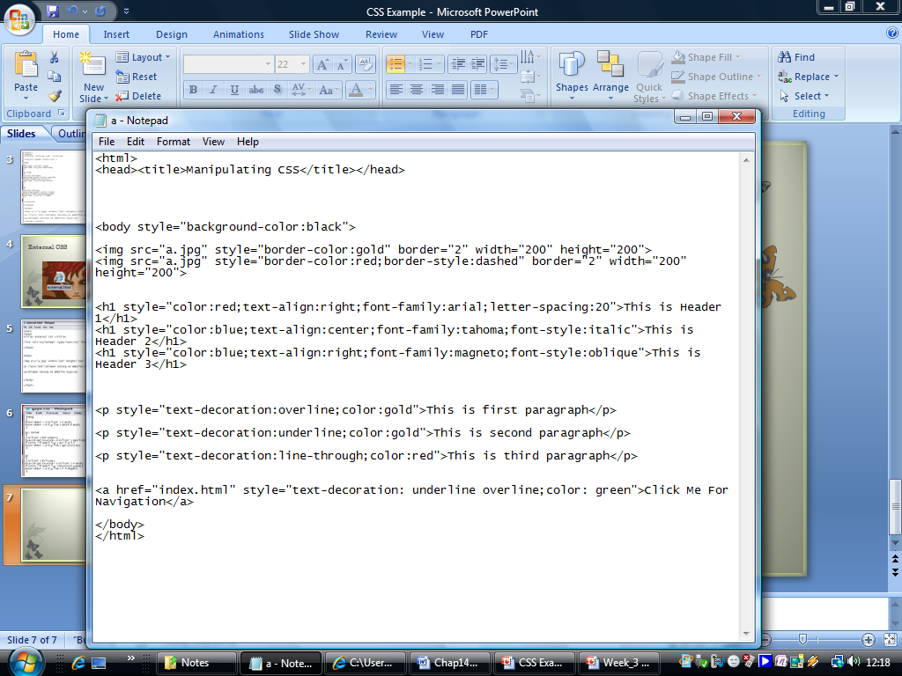
Exercise 2

